Slide 1

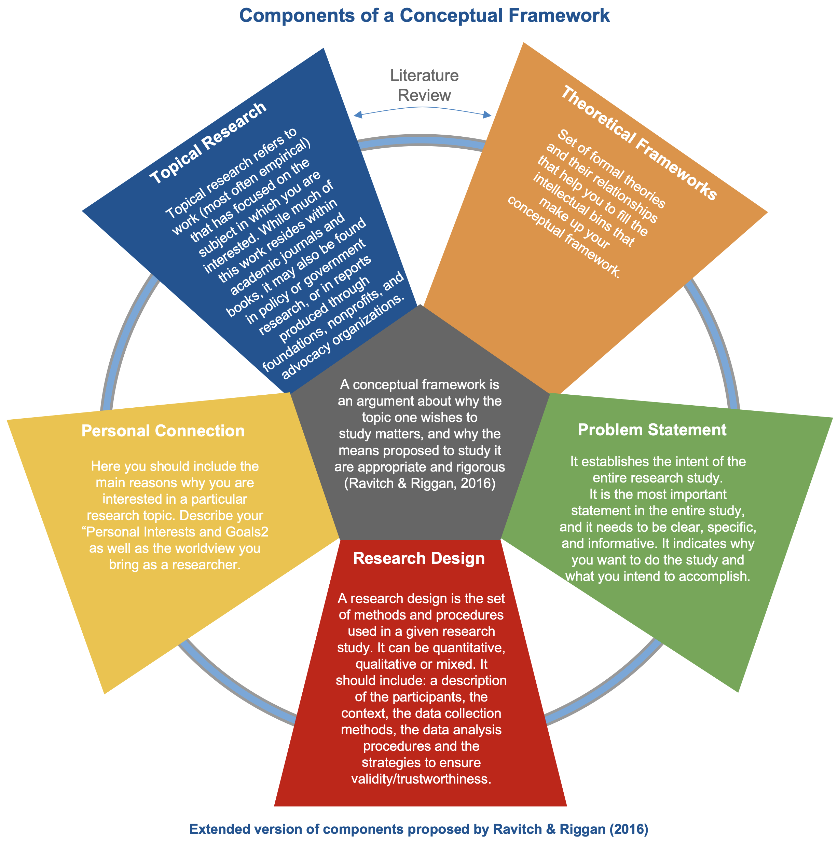
Email: <<email>>
Date: <<Timestamp>>
Research Topic: <<Define your research topic>>
Topical Research
Literature Review
Theoretical Frameworks
<<Topic 1>>
Gap/s Found:
<<Gap/s found in the review of your topical research>>
<<Theoretical Framework 1>>
Conceptual Framework: <<Name>>
<<Topic 2>>
<<Theoretical Framework 2>>
<<Topic 3>>
<<Theoretical Framework 3>>
<<Topic 4>>
<<Theoretical Framework 4>>
<<Topic 5>>
<<Theoretical Framework 5>>
Personal Interests & Goals
Problem Statement
<<Define your Personal Interests and Goals>>
<<Define your Problem Statement>>
Identity & Positionality
Research Questions
<<Describe your positionality and worldview >>
Research Design
<<Define your Research Question/s>>
<<Define your Research Design>>

Slide 2
Email: <<email>>
Date: <<Timestamp>>
Conceptual Framework: <<Name>>
Literature Review
Topical Research
Research Topic: <<Define your research topic>>
Theoretical Frameworks
Personal Interests & Goals
<<Define your Personal Interests and Goals>>
<<Topic 1>>
<<Theoretical Framework 1>>
<<Topic 2>>
<<Theoretical Framework 2>>
<<Topic 3>>
<<Theoretical Framework 3>>
<<Topic 4>>
<<Theoretical Framework 4>>
<<Topic 5>>
<<Theoretical Framework 5>>
Identity & Positionality
<<Describe your positionality and worldview >>
Gap/s Found:
<<Gap/s found in the review of your topical research>>
Problem Statement:
<<Define your Problem Statement>>
Research Questions:
<<Define your Research Question/s>>
Research Design:
<<Define your Research Design>>

Slide 3
Email: <<email>>
Date: <<Timestamp>>
Topical Research
Gap/s Found:
<<Gap/s found in the review of your topical research>>
Theoretical Frameworks
<<Topic 1>>
<<Theoretical Framework 1>>
<<Topic 2>>
<<Theoretical Framework 2>>
<<Topic 3>>
<<Theoretical Framework 3>>
<<Topic 4>>
<<Theoretical Framework 4>>
<<Theoretical Framework 5>>
<<Topic 5>>
Personal Interests & Goals
<<Define your Personal Interests and Goals>>
Research Topic:
<<Define your research topic>>
Problem Statement:
<<Define your Problem Statement>>
Research Design
<<Define your Research Design>>
Identity & Positionality
<<Describe your positionality and worldview >>
Research Questions
<<Define your Research Question/s>>
Conceptual Framework: <<Name>>
Email: <<email>>
Date: <<Timestamp>>

